Slide 1
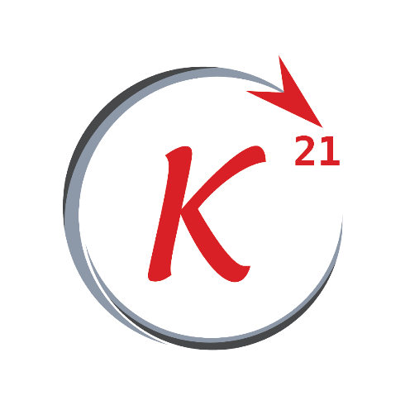
Python Basics

Slide 2
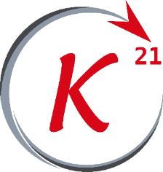
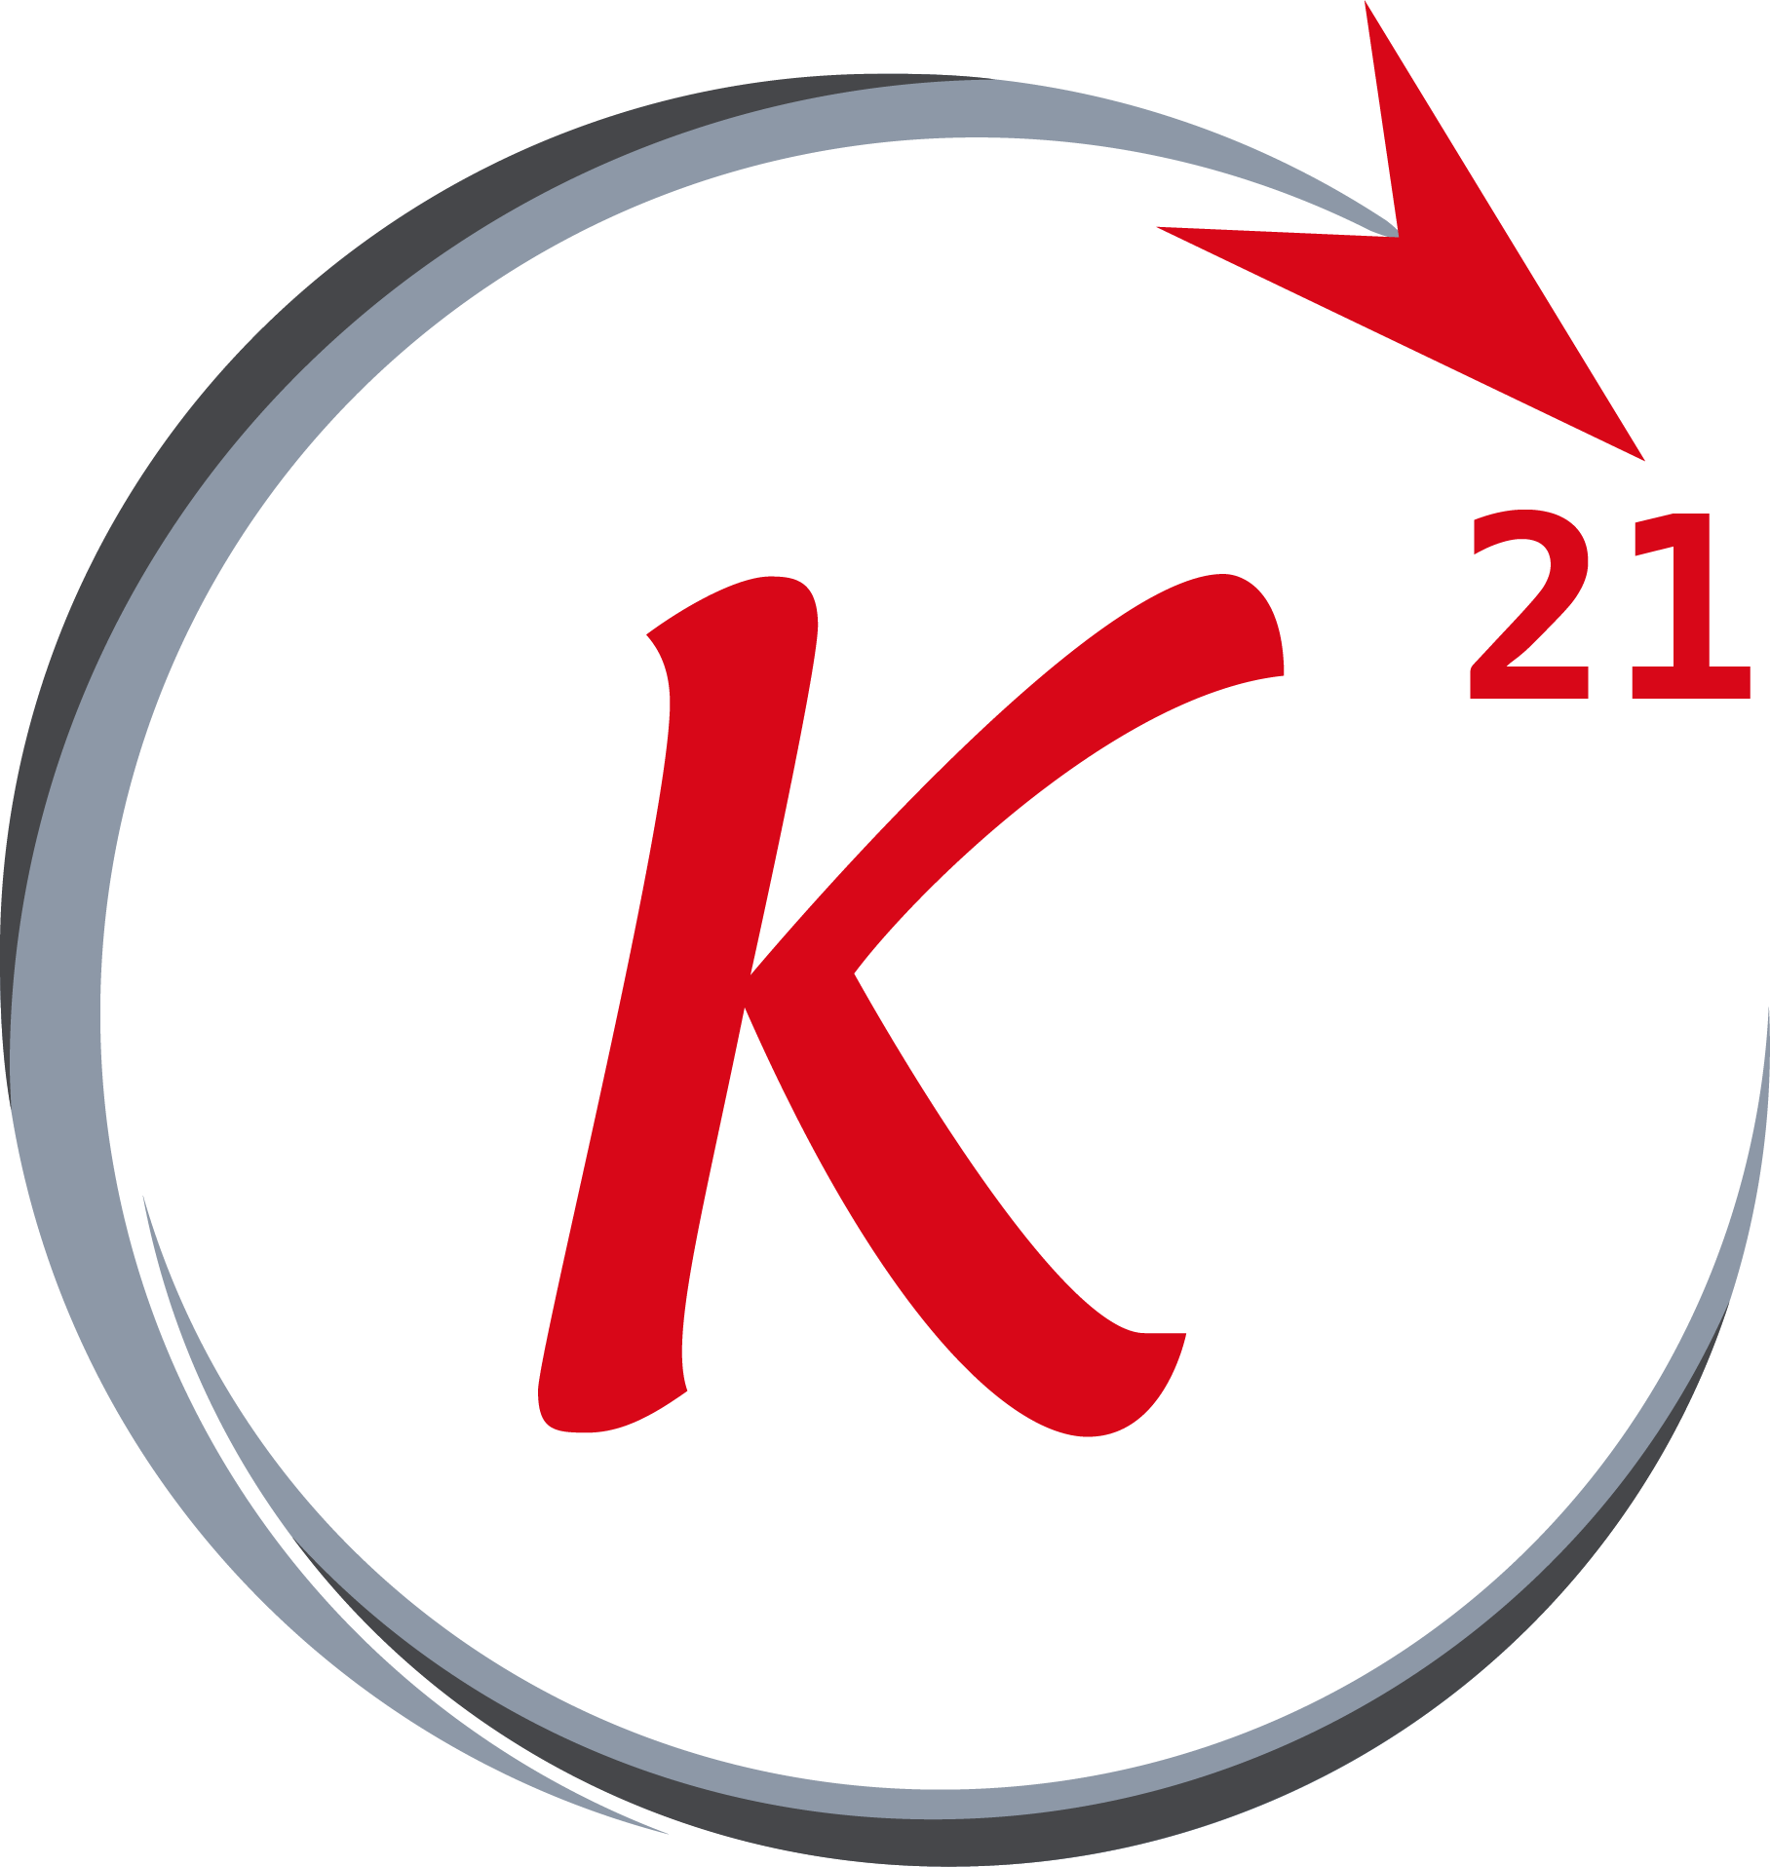


Python
Outline
About python
Program compilation and lifetime
Installation
Syntax
Data types (1)
Arithmetic operations
Data types (2)
Logic and execution flow
Functions
Classes
Grow Through

Slide 3
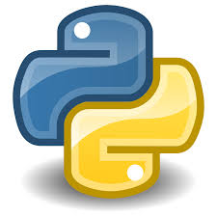
About Python
History
Python is a general-purpose programming language first introduced in 1991 by Guido van Rossum .
With python 2.0 being released in 2000 , and python 3.0 released in 2008 .
It is a high-level and dynamically typed language with garbage-
collection feature .
Grow Through

Slide 4
Program compilation
Python bytecode and P.V.M.
Python code is first compiled to python bytecode, a lower level language that python virtual machine uses to execute each line of code typed in the source code, the PVM is installed by the python installer and runs on top of the operating system (Windows, MacOS, etc.. ) .
The bytecode when cached is stored in .pyc file and if no change made in the source code file, python skips the compilation to bytecode process and uses the old cached bytecode file.
Grow Through

Slide 5
Program compilation
Python bytecode and P.V.M.
Insert a visual example of bytecode + check about __pycache__ file
Grow Through

Slide 6
Program lifetime
Objects lifetime
Insert a visual example of bytecode + check about __pycache__ file
Grow Through

Slide 7
Installation
Python & IDLE
Python is downloaded from the official website blah blah
It comes with IDLE which is a simple python text editor used to type and edit python file .
We will be using python 3.8.6 in this workshop .
Grow Through

Slide 8
Installation
IDE : VS-Code
A very popular and open-source IDE to use is visual studio code, it has a python extension made and maintained by Microsoft .
Add vs code logo and python extension scrn shot in here
Grow Through

Slide 9
Syntax
placeholder
Sort what to be typed :
Comments
Definitions
Indentation
Use w3school
Finish slides 5,6,8 and add a photo in 7
Grow Through

